Slide 1

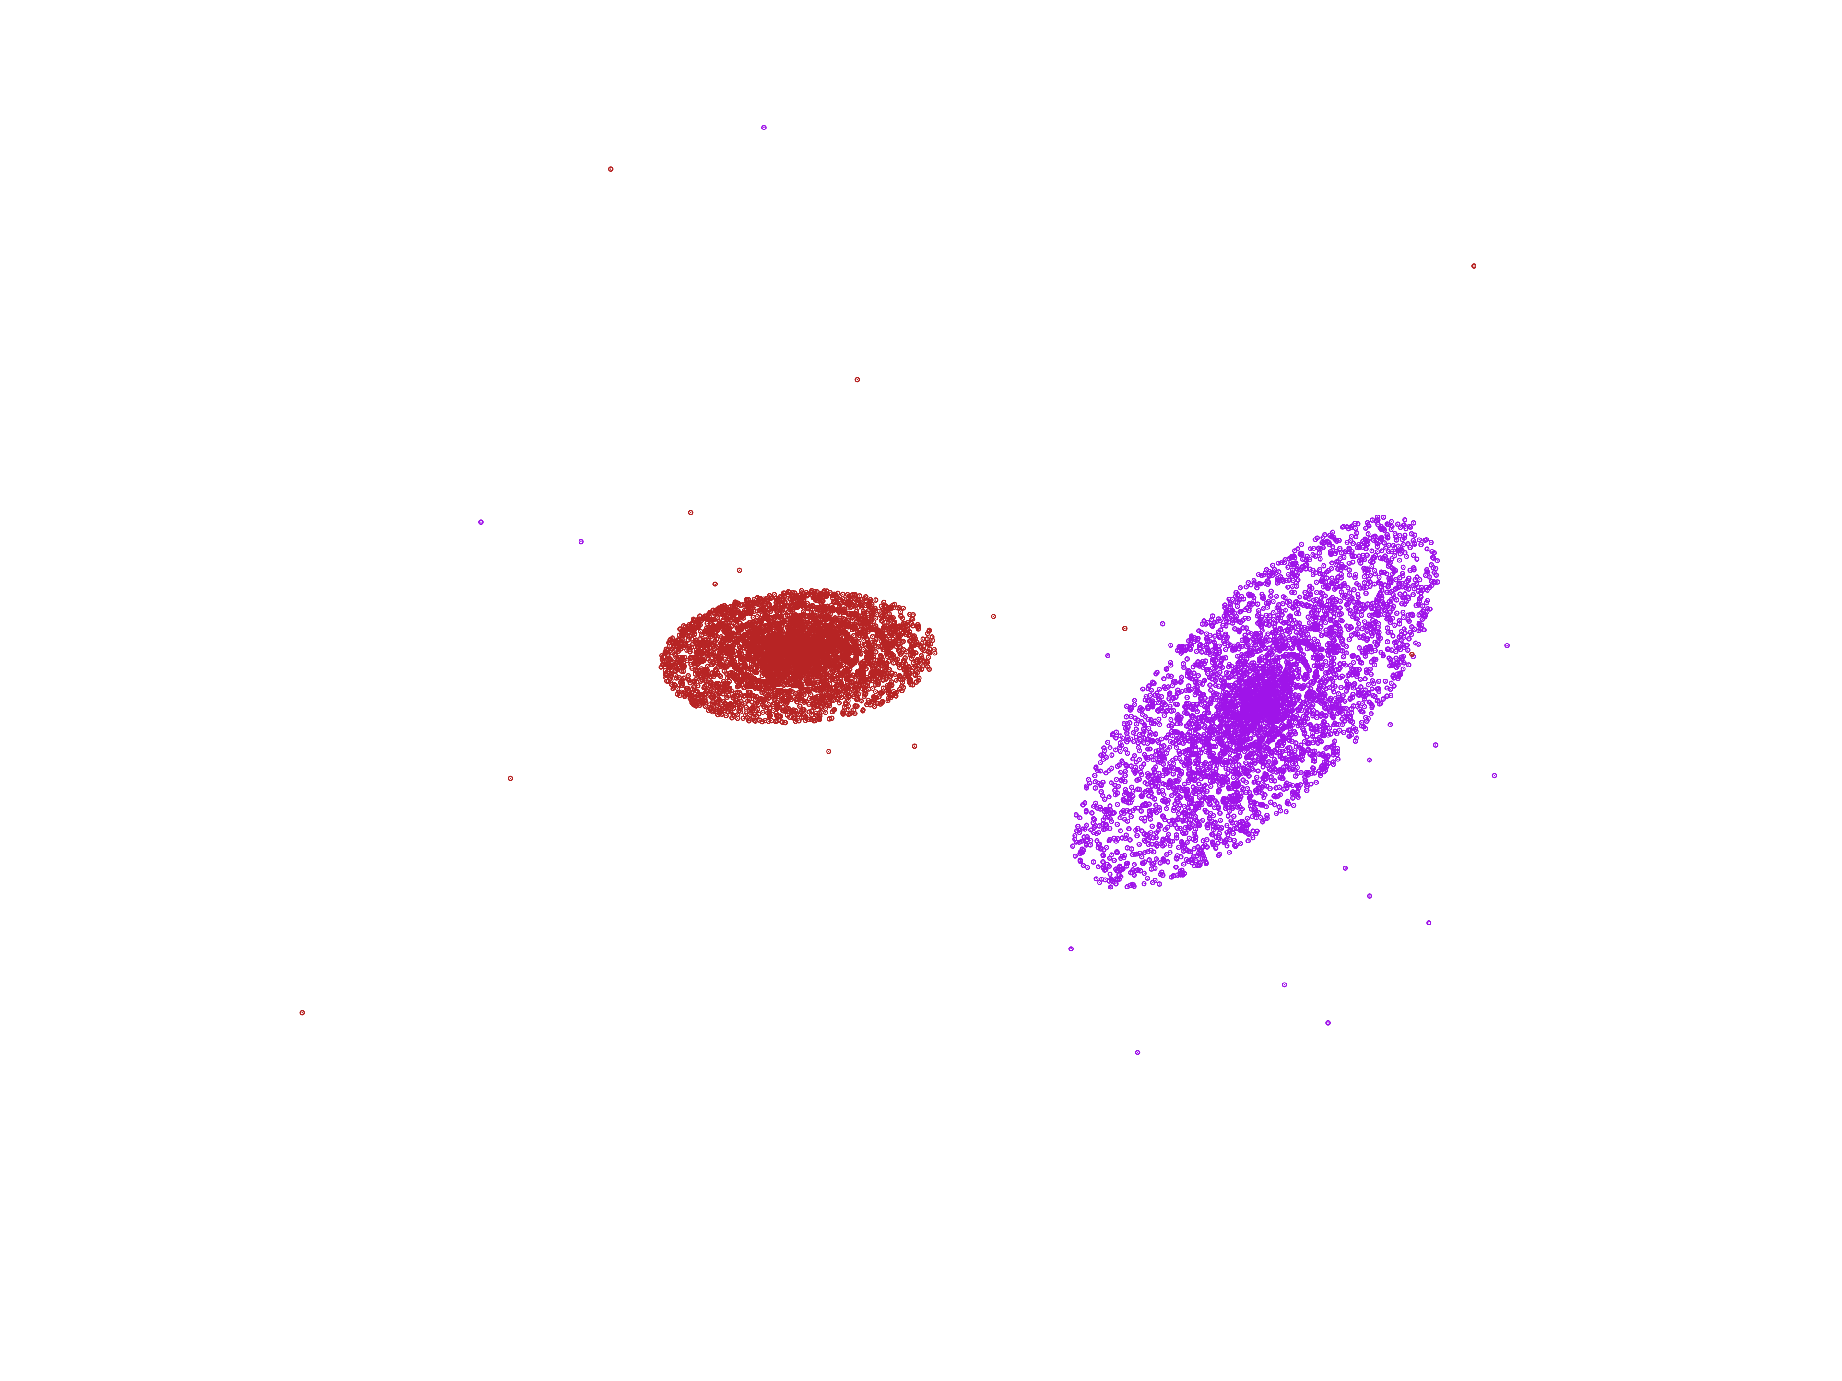
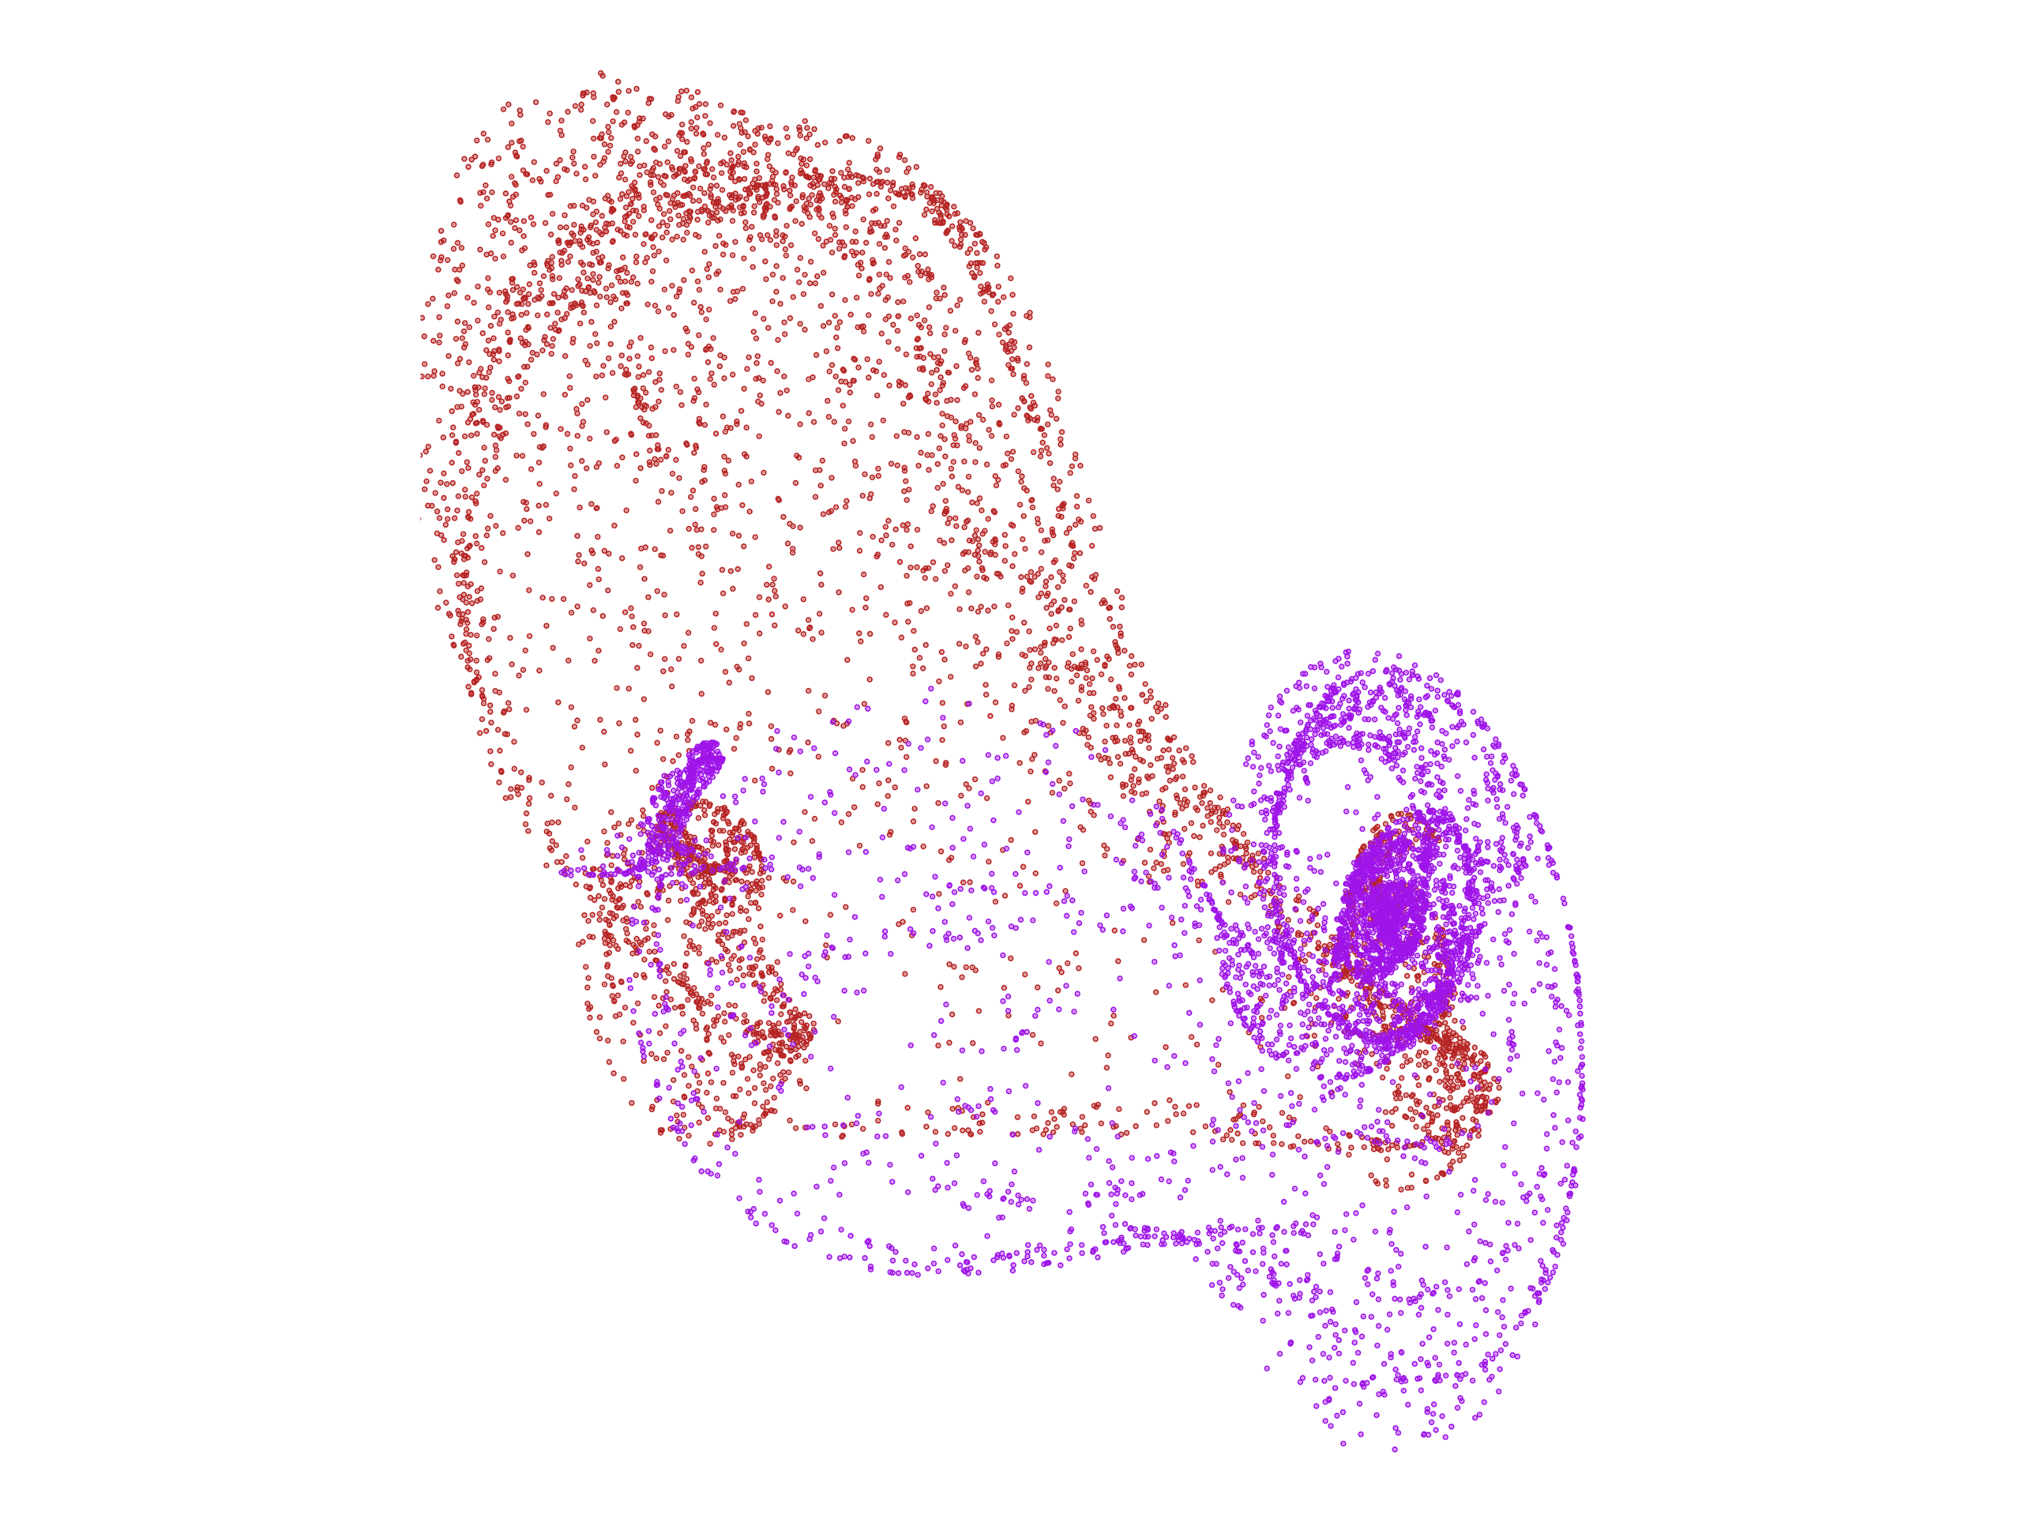
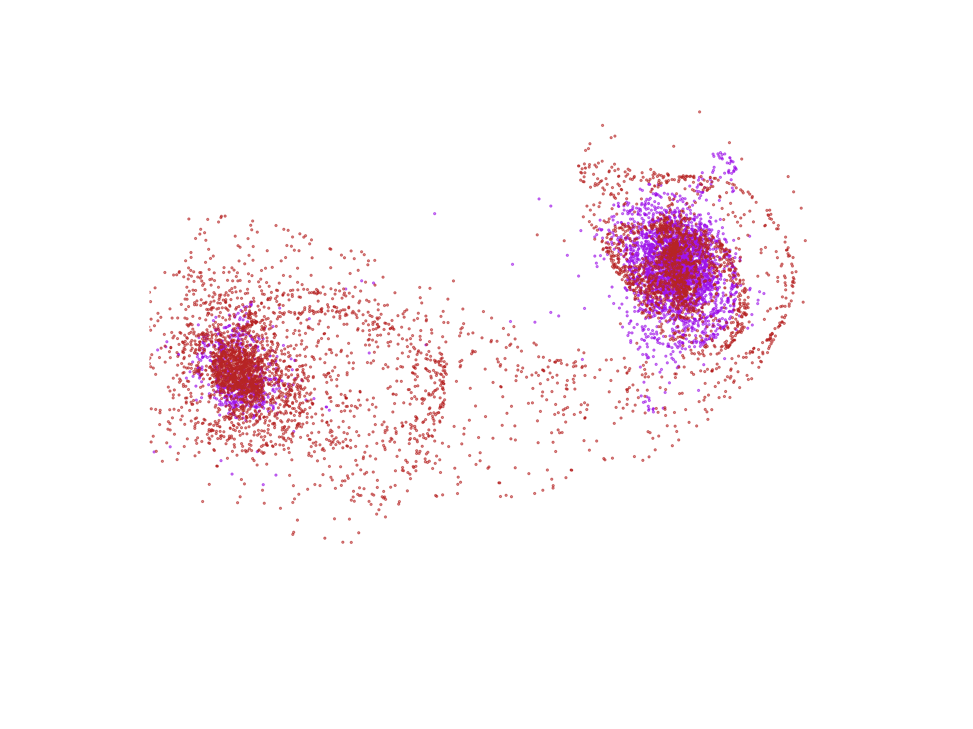
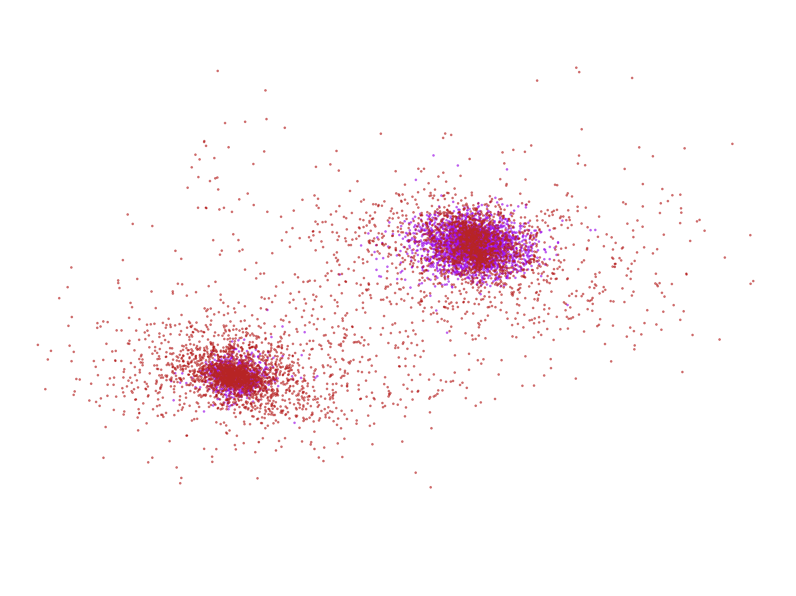
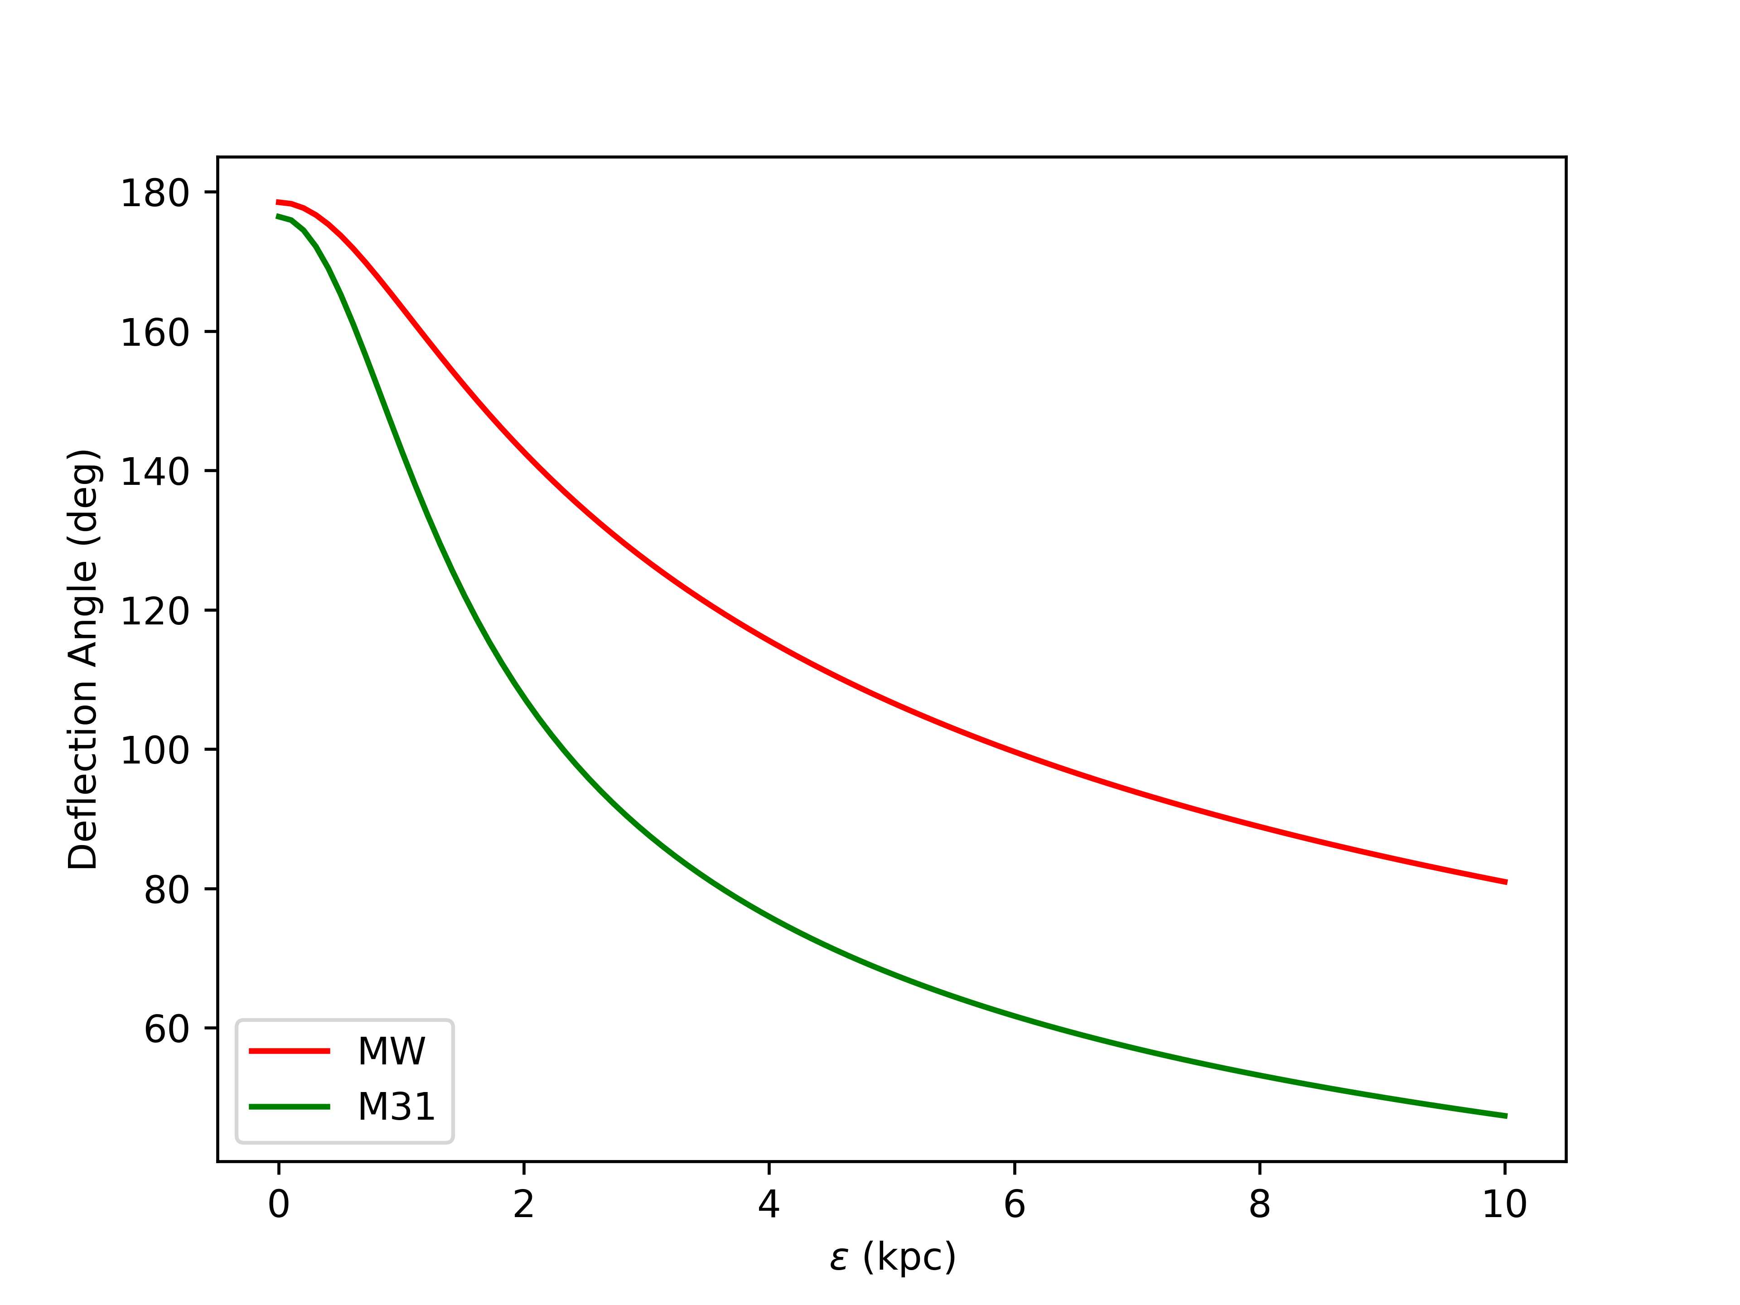
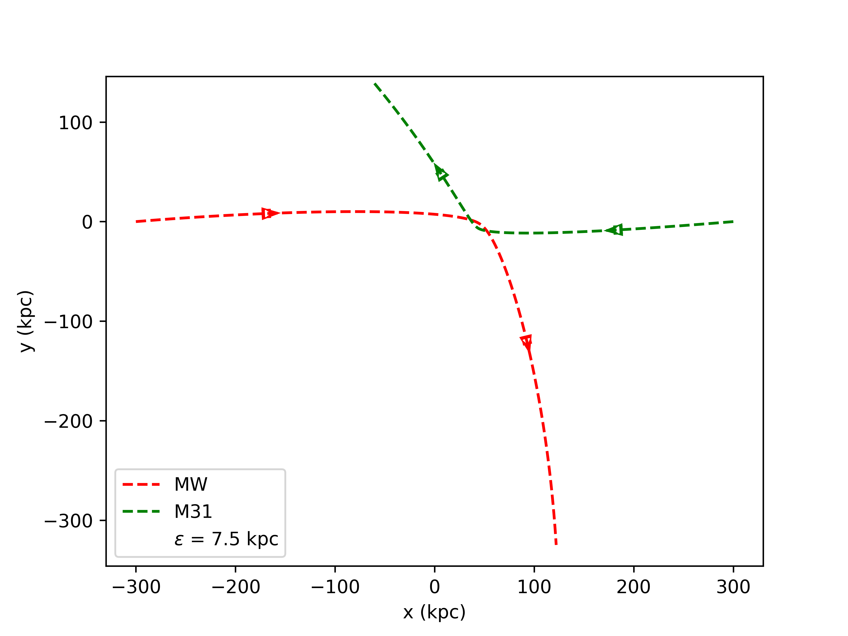
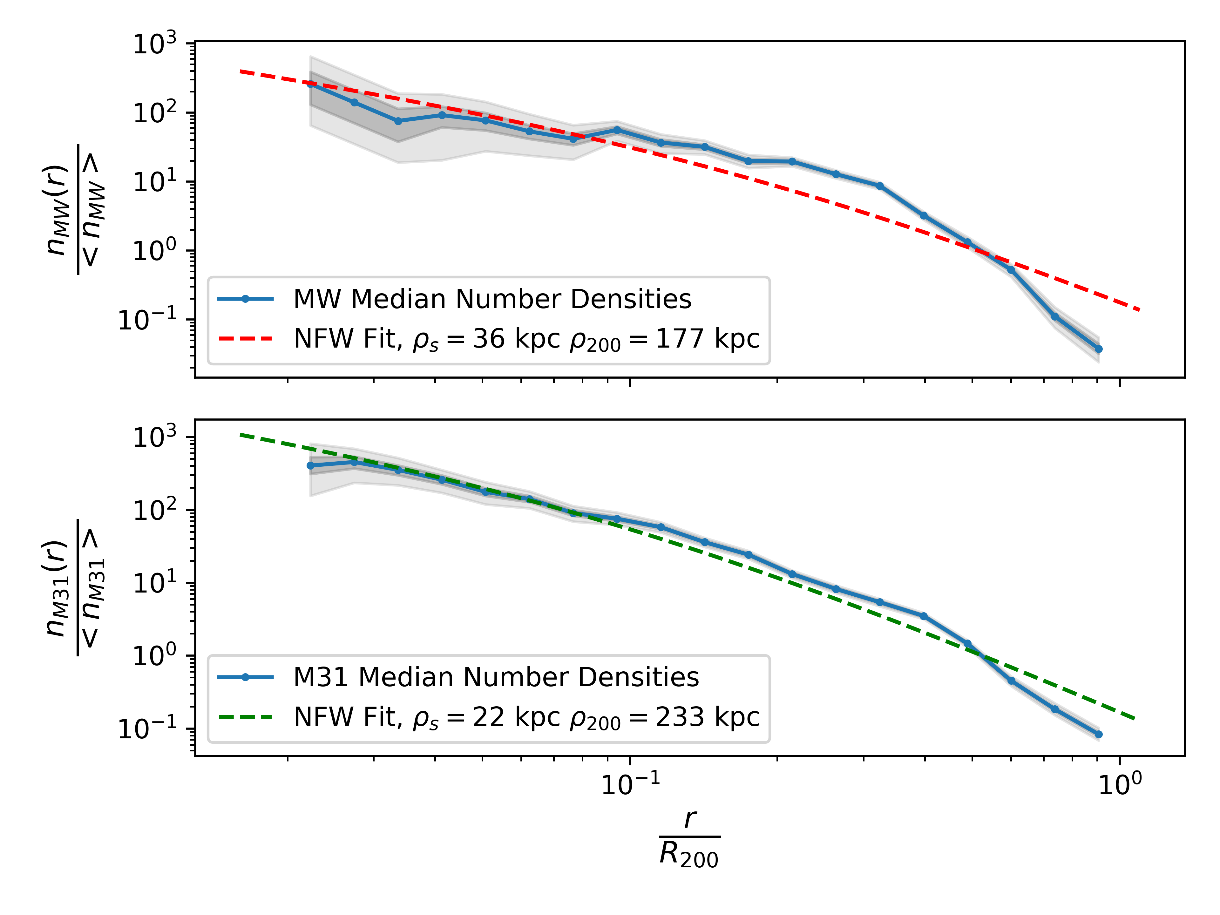
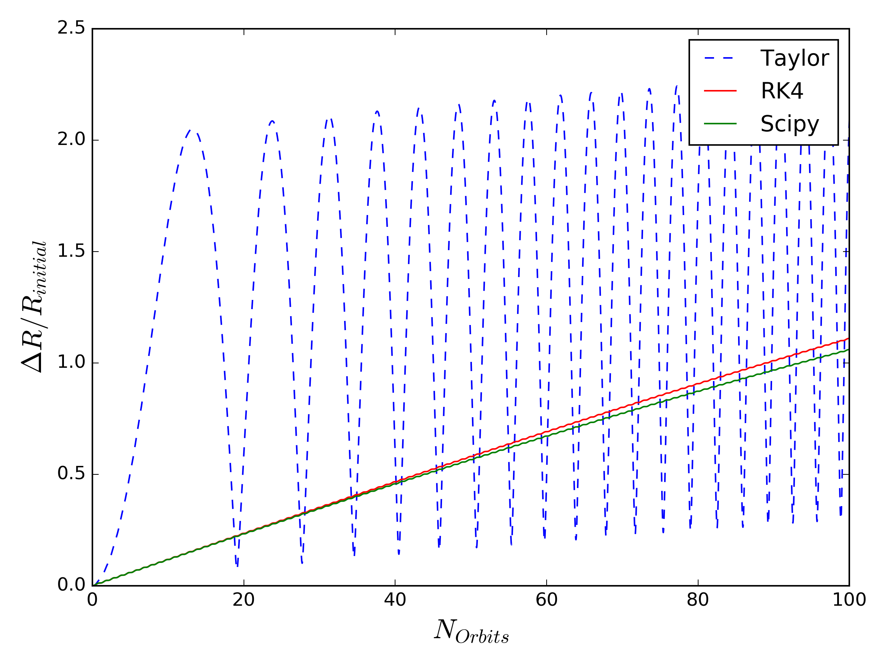
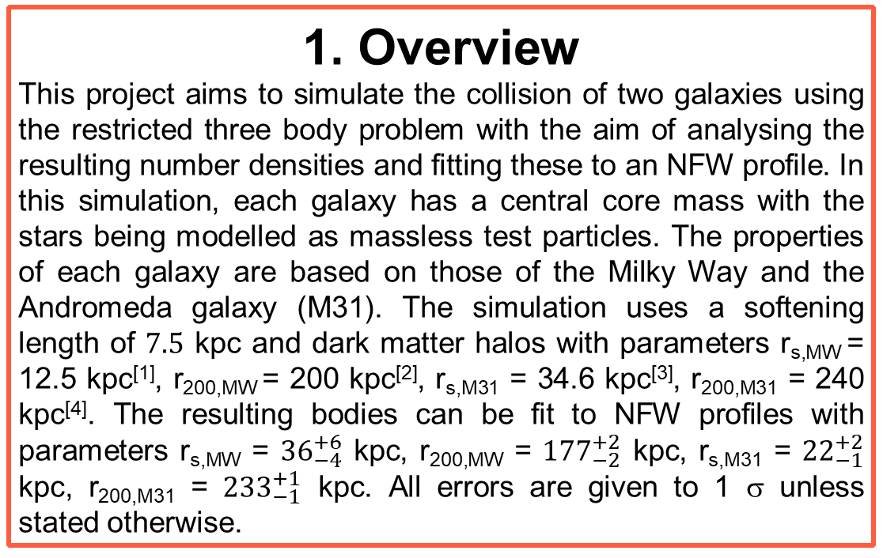
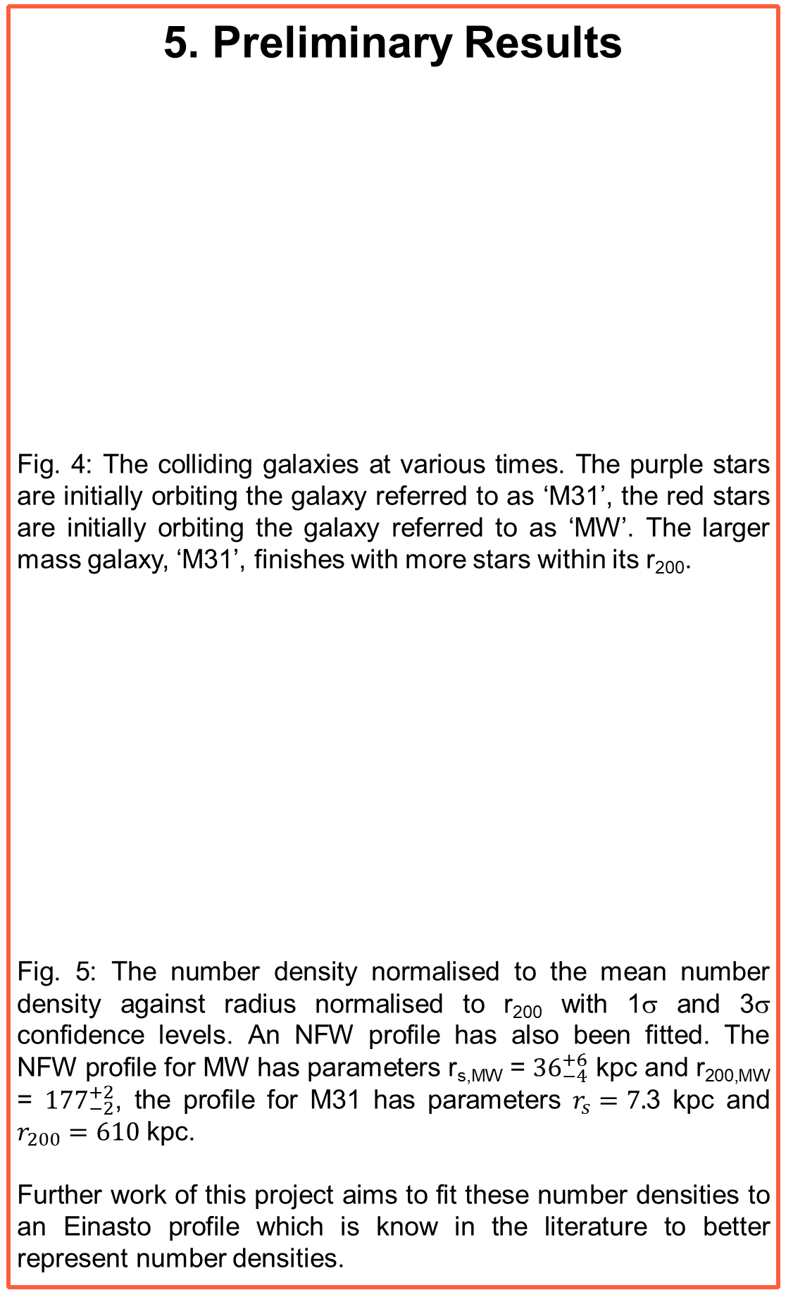
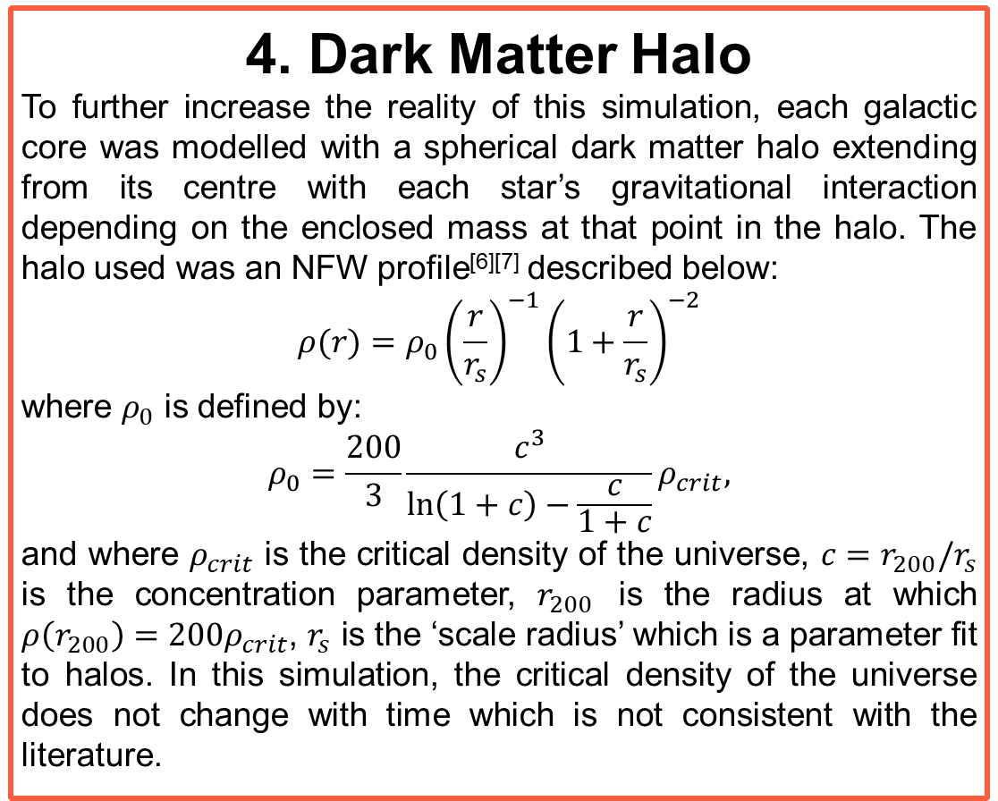
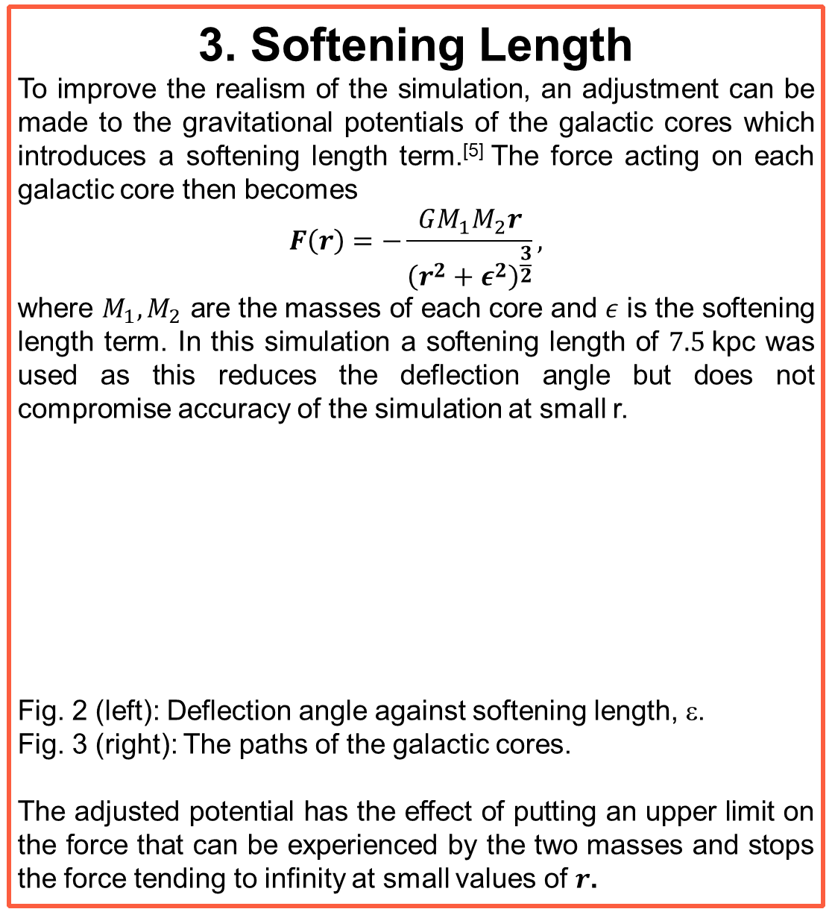
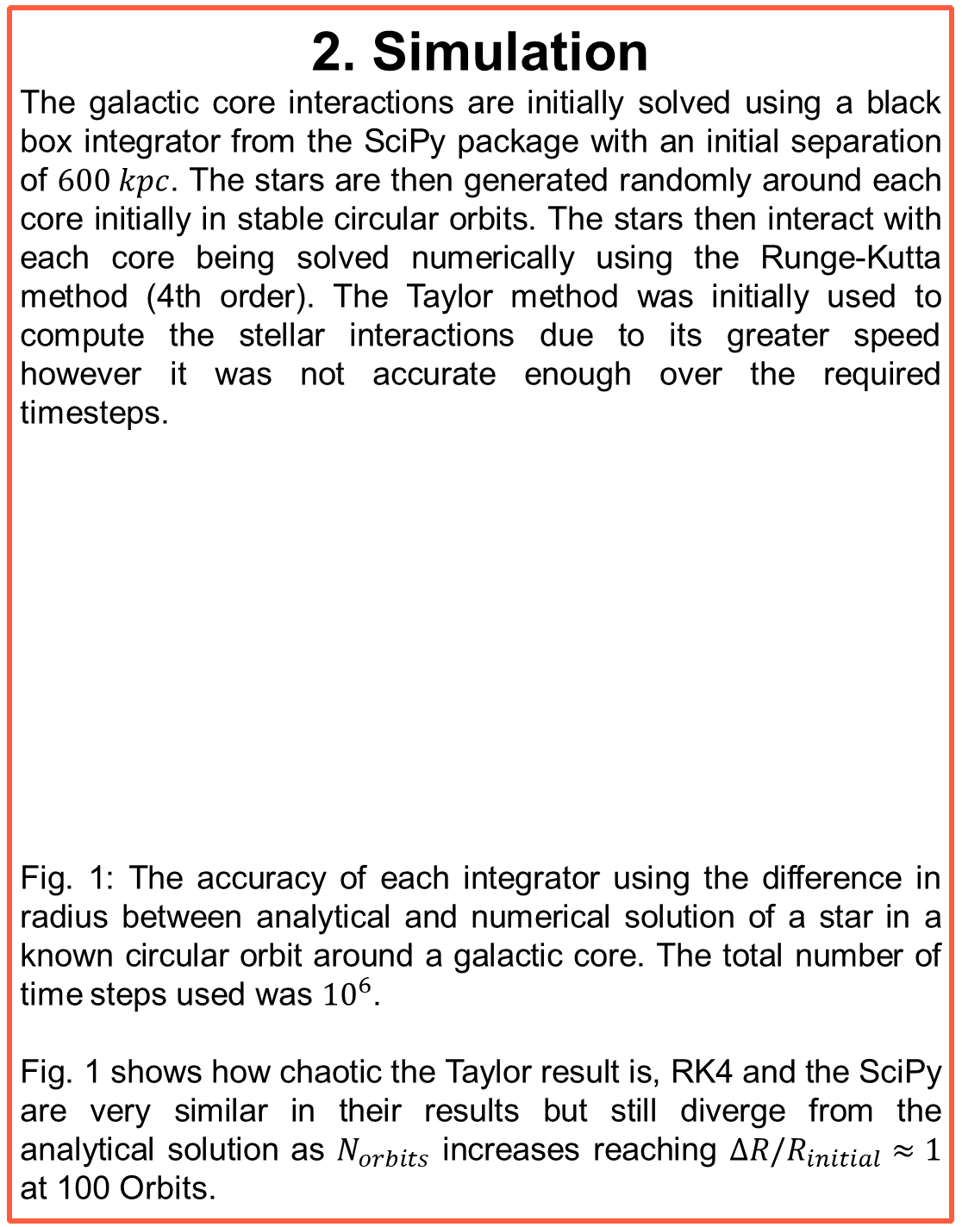
Colliding Galaxies
Andrew Baldacchino
1. Overview
This project aims to simulate the collision of two galaxies using the restricted three body problem with the aim of analysing the resulting number densities and fitting these to an NFW profile. In this simulation, each galaxy has a central core mass with the stars being modelled as massless test particles. The properties of each galaxy are based on those of the Milky Way and the Andromeda galaxy (M31). The simulation uses a softening length of $7.5$ kpc and dark matter halos with parameters r_{s,MW} = 12.5 kpc^{[1]}, r_{200,MW} = 200 kpc^{[2]}, r_{s,M31} = 34.6 kpc^{[3]}, r_{200,M31} = 240 kpc^{[4]}. The resulting bodies can be fit to NFW profiles with parameters r_{s,MW} = ${36}_{−4}^{+6}$ kpc, r_{200,MW} = ${177}_{−2}^{+2}$ kpc, r_{s,M31} = ${22}_{−1}^{+2}$ kpc, r_{200,M31} = ${233}_{−1}^{+1}$ kpc. All errors are given to 1 σ unless stated otherwise.
3. Softening Length
To improve the realism of the simulation, an adjustment can be made to the gravitational potentials of the galactic cores which introduces a softening length term.^{[5]} The force acting on each galactic core then becomes
$$F\left(r\right)=−\frac{GM_{1}M_{2}r}{{\left(r^{2}+ε^{2}\right)}^{\frac{3}{2}}},$$
where $M_{1},M_{2}$ are the masses of each core and $ε$ is the softening length term. In this simulation a softening length of $7.5$kpc was used as this reduces the deflection angle but does not compromise accuracy of the simulation at small r.
Fig. 2 (left): Deflection angle against softening length, ε.
Fig. 3 (right): The paths of the galactic cores.
The adjusted potential has the effect of putting an upper limit on the force that can be experienced by the two masses and stops the force tending to infinity at small values of $r$.
5. Preliminary Results
Fig. 4: The colliding galaxies at various times. The purple stars are initially orbiting the galaxy referred to as ‘M31’, the red stars are initially orbiting the galaxy referred to as ‘MW’. The larger mass galaxy, ‘M31’, finishes with more stars within its r₂₀₀.
Fig. 5: The number density normalised to the mean number density against radius normalised to r₂₀₀ with 1σ and 3σ confidence levels. An NFW profile has also been fitted. The NFW profile for MW has parameters r_{s,MW} = ${36}_{−4}^{+6}$ kpc and r_{200,MW} = ${177}_{−2}^{+2}$, the profile for M31 has parameters $r_{s}=7.$3 kpc and $r_{200}=610$ kpc.
Further work of this project aims to fit these number densities to an Einasto profile which is know in the literature to better represent number densities.
2.5 Gyr
4 Gyr
(1)
8 Gyr
40 Gyr
2. Simulation
The galactic core interactions are initially solved using a black box integrator from the SciPy package with an initial separation of $600 kpc$. The stars are then generated randomly around each core initially in stable circular orbits. The stars then interact with each core being solved numerically using the Runge-Kutta method (4th order). The Taylor method was initially used to compute the stellar interactions due to its greater speed however it was not accurate enough over the required timesteps.
Fig. 1: The accuracy of each integrator using the difference in radius between analytical and numerical solution of a star in a known circular orbit around a galactic core. The total number of time steps used was ${10}^{6}$.
Fig. 1 shows how chaotic the Taylor result is, RK4 and the SciPy are very similar in their results but still diverge from the analytical solution as $N_{orbits}$ increases reaching $ΔR/R_{initial}≈1$ at 100 Orbits.
4. Dark Matter Halo
To further increase the reality of this simulation, each galactic core was modelled with a spherical dark matter halo extending from its centre with each star’s gravitational interaction depending on the enclosed mass at that point in the halo. The halo used was an NFW profile^{[6][7]} described below:
$$ρ(r)={ρ_{0}\left(\frac{r}{r_{s}}\right)}^{−1}{\left(1+\frac{r}{r_{s}}\right)}^{−2}$$
where $ρ_{0}$ is defined by:
$$ρ_{0}=\frac{200}{3}\frac{c^{3}}{\ln\left(1+c\right)−\frac{c}{1+c}}ρ_{crit},$$
and where $ρ_{crit}$ is the critical density of the universe, $c=r_{200}/r_{s}$ is the concentration parameter, $r_{200}$ is the radius at which $ρ\left(r_{200}\right)=200ρ_{crit}$, $r_{s}$ is the ‘scale radius’ which is a parameter fit to halos. In this simulation, the critical density of the universe does not change with time which is not consistent with the literature.
(2)
(3)
References
[1] Sofue, Yoshiaki. ‘A Grand Rotation Curve and Dark Matter Halo in the Milky Way Galaxy’ (25 August 2012)
[2] Dehnen, Walter, Dean E. McLaughlin, and Jalpesh Sachania. ‘The Velocity Dispersion and Mass Profile of the Milky Way’ (1 July 2006)
[3] Sofue, Yoshiaki. ‘Dark Halos of M 31 and the Milky Way’. (1 August 2015)
[4] Kafle et al. ‘The Need for Speed: Escape Velocity and Dynamical Mass Measurements of the Andromeda Galaxy’ (January 2018)
[5] C. C. Dyer, and P. S. S. Ip. “Softening in N-Body Simulations of Collisionless Systems.” (May 20, 1993)
[6] Navarro, Julio F., Carlos S. Frenk, and Simon D. M. White. “The Structure of Cold Dark Matter Halos.” (May 1, 1996)
[7] Read, J. I. “The Local Dark Matter Density.” (June 1, 2014

